Slide 1


Library Management Database System
A comprehensive database solution for Kabul University's library resources. Created by Murtaza Hussaini, Jawid Muradi & Farid Wardak, 2025.
Create by Jaweid Moraadi , Murtaza Husaini & Farid W
Supervised by Professors Gharani – Database project 2025”

Slide 2

What is a Library?
A library is an organized collection of books and other informational resources. These collections serve communities for reading, study, and reference.
Modern libraries incorporate digital systems. These systems manage books, users, staff, and various operations.

Slide 3





Why Use a Database for a Library?
Efficient Management
Manage large numbers of books, students, and staff easily.
Quick Search
Instantly find books and member information.
Security
Protect data with controlled access systems.
Reporting
Generate insights on book usage and overdue items.

Slide 4






ER Diagram Overview
Users
Students and Faculty entities
Resources
Book and material entities
Operations
Registration and Transaction entities
The Entity-Relationship Diagram shows how library components connect. Entities relate through primary and foreign keys.

Slide 5
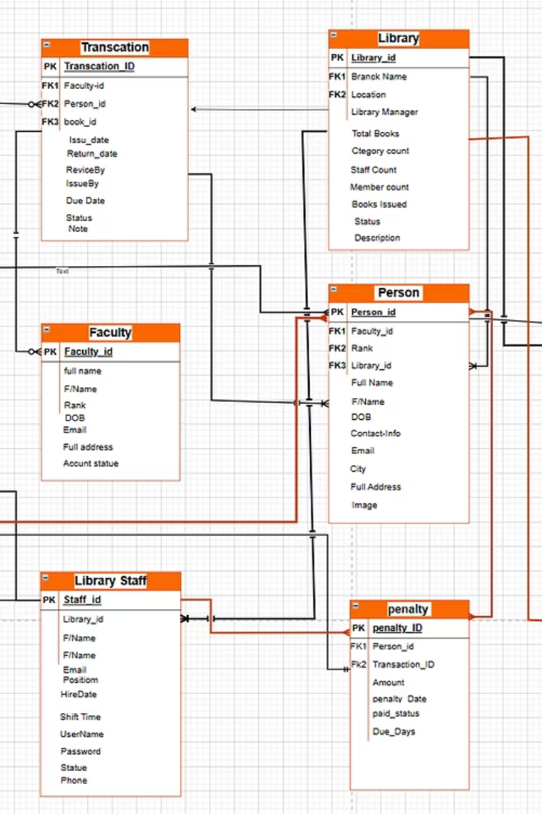
Database Schema Design
Entities
Relationships
Registration, Person, Faculty, Book, and Transaction tables form the core structure.
Connections between tables establish a complete operational framework.
Data Integrity
Primary and foreign keys ensure consistent and reliable data.

Slide 6
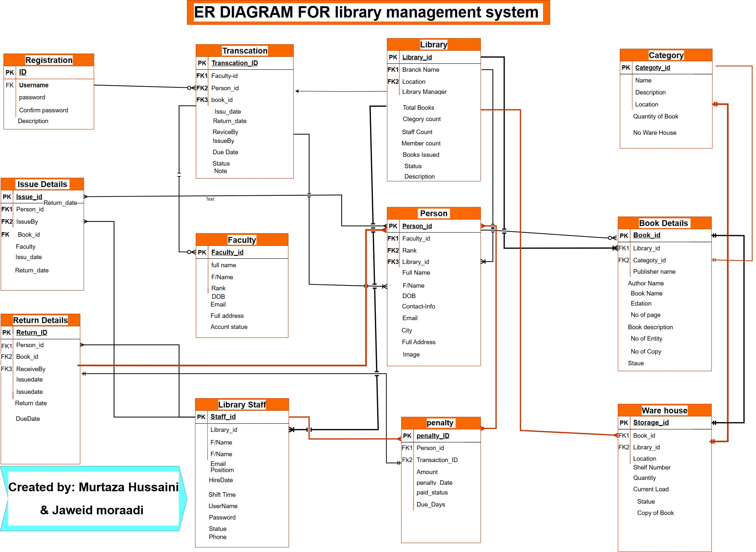
Fk

Slide 7
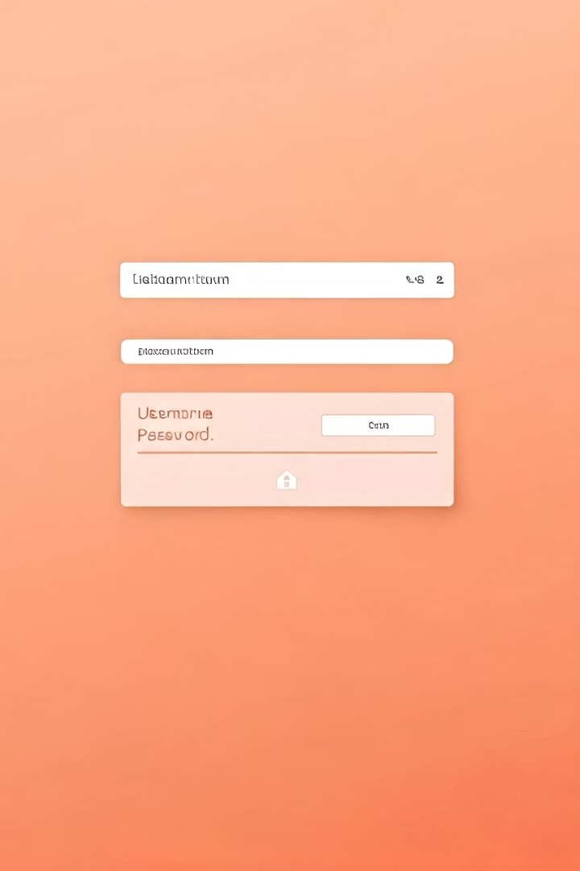
Registration Table
Field Name
Data Type
Description
ID
Integer
Primary Key
Username
Varchar
Foreign Key
Password
Varchar
Encrypted
Confirm Password
Varchar
Validation
Description
Text
Additional notes
The Registration table maintains a 1:1 relationship with the Transaction table.

Slide 8





Person Table
Identification
Person_id (PK), Faculty_id (FK1), Rank (FK2)
Personal Info
Full Name, F/Name, DOB
Contact Details
Contact-info, Email, City, Full Address
Visual ID
Image

Slide 9








Faculty Table
Identity Fields
Professional Info
Faculty_id (PK), Full name, F/Name
Rank, DOB
Status
Contact Details
Account Status
Email, Full Address
Maintains an M:1 optional relationship with the Transaction table.

Slide 10



Transaction Table
Identifiers
Transaction_ID (PK), Faculty-id (FK1), Person_id (FK2), book_id (FK3)
Dates
Issue Date, Return Date
Relationships
Faculty (1:M), Person (1:M), Registration (M:1)

Slide 11



Book Details Table
Primary Fields
Book_Id (PK), Book Name, Author Name, Publisher Name
Publication Info
Edition, Book cost, No. of pages, Book Description
Inventory Data
No of Entity, No of copy, Status
The main table in the ER Diagram with M:1 Optional relationship to Person table and 1:1 Mandatory relationship to Warehouse table.

Slide 12





Return Details Table
Logging Returns
Tracks book returns by person, ensuring accurate records.
Key Fields
Includes return ID (PK), person, book, and receiver IDs (FKs).
Date Tracking
Captures return and due dates for reference.
Penalty Link
Mandatory 1:1 relationship with the Penalty table.

Slide 13
Category Table
Categorizing Books
Inventory Data
Key Relationships
Organizes books into subjects for easy retrieval.
Records quantity and warehouse information.
Mandatory 1:1 links with Book Details and Warehouse.
Category_id (PK)
Quantity of Book
Name
No. warehouse
Location
Description

Slide 14

Warehouse Table
Book Storage
Manages the physical inventory of books.
Tracking Fields
Includes storage ID (PK), book ID (FK), location, and shelf number.
Inventory Metrics
Records quantity, current load, and status.
Core Relationships
Mandatory 1:1 relationships with Book Details and Category tables.

Slide 15





Library Table (Main Table)
Branch Details
Library ID (PK)
2
Name, location, and manager information.
Unique identifier for each branch.
1
Summary Counts
3
Total books, categories, staff, and members.
Key Relationships
5
M:1 mandatory links to Person, Book Details, Warehouse, and Library Staff.
Operational Status
4
Tracks books issued and overall status.

Slide 16





Library Staff Table
This database efficiently handles user registrations, book inventories, and borrow/return activities. It uses well-defined relationships to ensure data integrity and is scalable for future additions like fines, notifications, or user analytics.
Staff ID (PK)
Personal Details
Employment Info
Unique identifier for each employee.
Full name, email, and phone number.
Position, hire date, and shift time.
Access Credentials
Username and password for system access.

Slide 17





Penalty Table
Purpose
Key Fields
Manages penalties for overdue book returns.
Penalty_ID (PK), Person_id (FK), Transaction_ID (FK).
Tracking Details
Relationships
Amount, penalty date, paid status, and due days.
Foreign keys link to Person and Transaction tables.

Slide 18

Conclusion
Clear Structure
System provides a clear view of library operations.
System Interaction
Shows interactions between users, books, and the database.
Foundation Model
Simplified yet functional for implementation or understanding.
Enhanced Efficiency
Improves library efficiency and data tracking.

Slide 19

Want to Learn More?
If you're interested in exploring the full diagram and the complete presentation, or want more information:
—
—
Visit our GitHub project:
You'll find:
https://github.com/hussaini021/Library_management
The full diagram of Structure in draw.io file
The full system diagram (image file)
This presentation file
—
Detailed README
Explaining the purpose and contents.
Feel free to check it out, give feedback, or use it for learning!

